Slide 1
ELECTRONICA-ICT Project ontwerpen

Slide 2
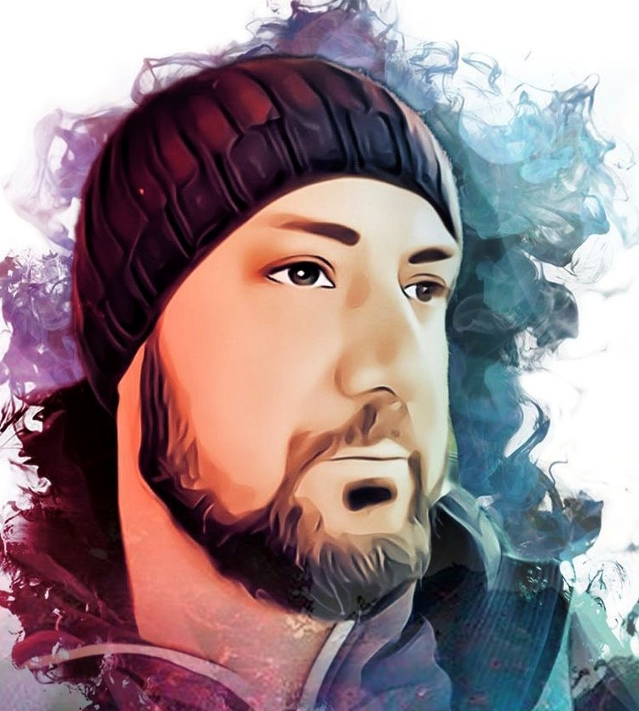
Hello!
I am Miguel Nunez
I am here to talk about my prototyping project.
You can find me at:
github.com/Sicatriz

Slide 3
1.
Introduction
Why this project?
Notes:
To start, I want to ask the question; why THIS project?
My initial plan was to make a word clock like the QlockTwo from BIEGERT & FUNK.
Mr Hilven conviced me that the wordclock wasn’t challenging enough for this course and proposed the soldering iron cause its wider range of components.

Slide 4
“If your goals don’t scare you, they aren’t big enough.” -Ellen J. Sirleaf
Notes:
When I thought this trough, I set high goals for this project, a simple copy/paste of elektors station wasn’t challenging enough.., I thought ☺

Slide 5
Extra features
I would do

Slide 6
Soldering station
Elektor Magazine key features
Multiple irons can be used
C++ coded IC
7-segment display
3D printed enclosure
Temperature control
Desired extra features
Fan to extrude solder fumes
Manipulation of C++ code for fan speed regulation
LED light to illuminate the workpiece
Durable, solid and heat resistant enclosure

Slide 7
Main PCB
POWER UNIT
3 power circuits
12V or 24V 12V 5V
REGULATOR
Transistors
MOSFET
1
2
OPAMPS
AMPLIFIER
ATMEGA 4809
LOGIC and CONNECTORS
3
4

Slide 8
OTHERS
DISPLAY
Separate PCB
With rotary encoder
LED & FAN
3th PCB
Fan needs PWM control
1
2
For electronics and soldering iron support
ENCLOSURE
Manipulation of code
C++
3
4

Slide 9
Roadmap
Find components in a market with supply chain issues
Create flawless schematics and design a stable PCB
Make my prototype build
1
3
5
2
4
6
Learn the software and build my libraries
Design an enclosure for the station with the additional features
TROUBLE SHOOT IT

Slide 10
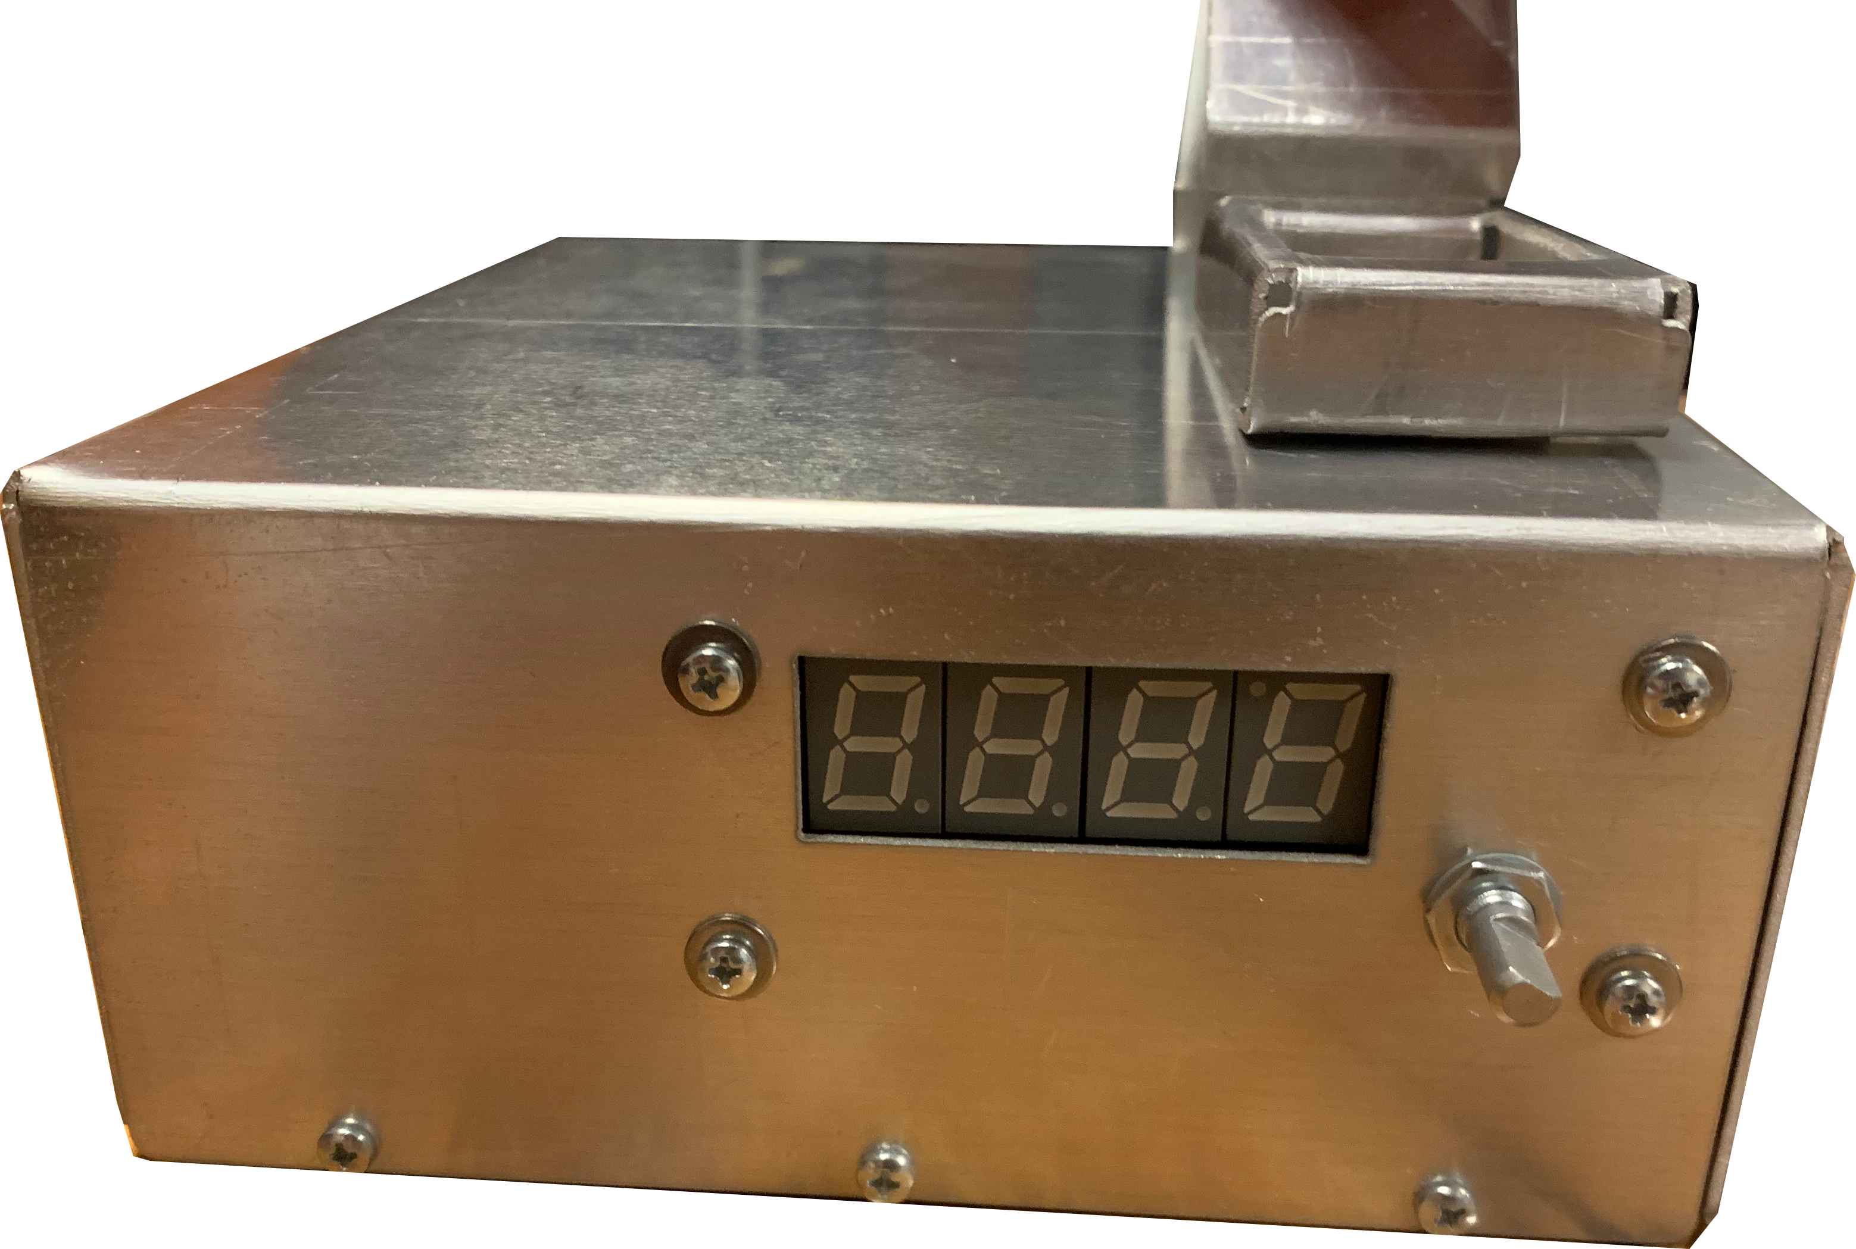
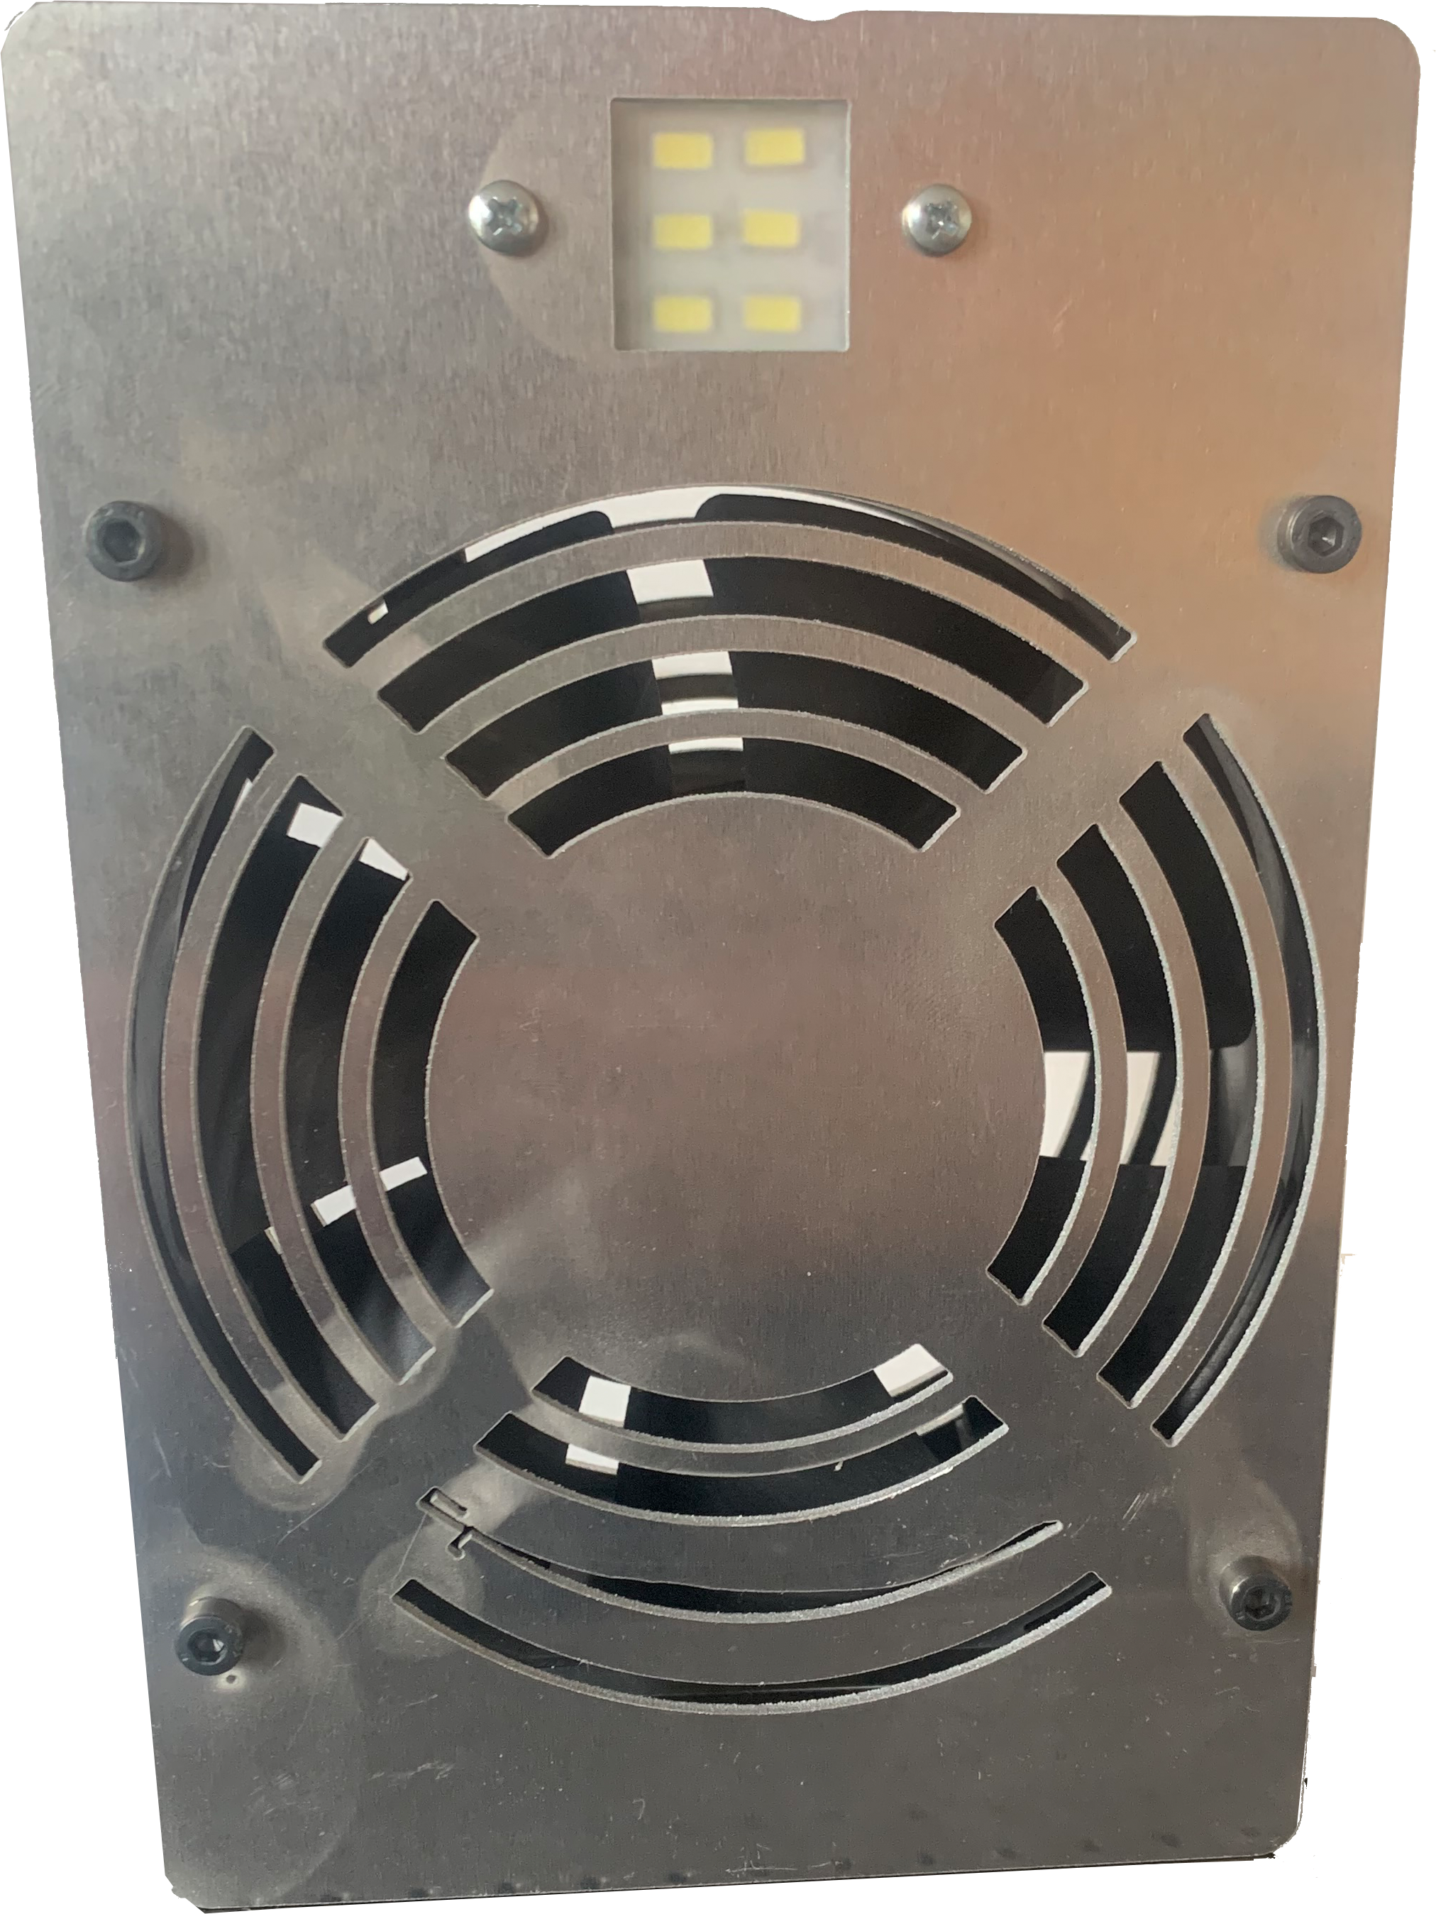
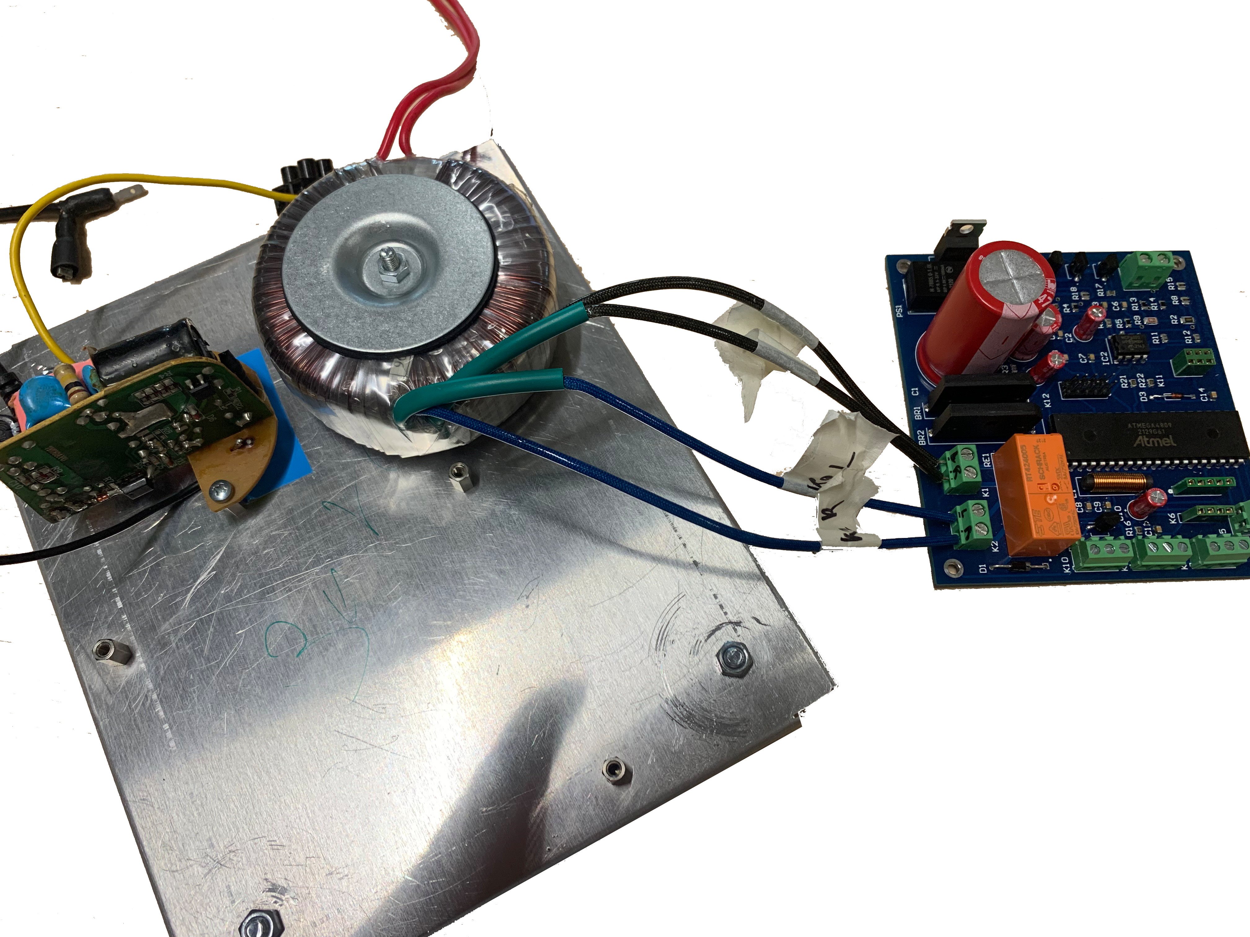
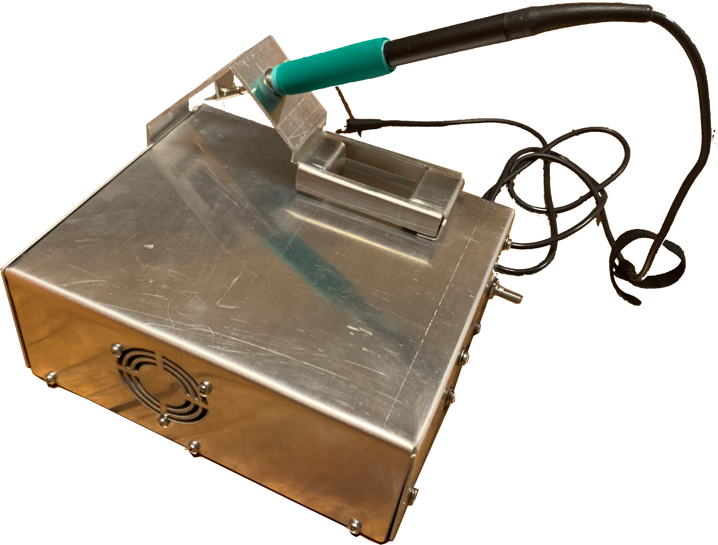

Slide 11
Special acknowledgements
Lectors
Patrick Hilven
Frederik Vreys
Ward Martens
Koen Gilissen
Dieter Vanrykel
Others
Wurth Elektronics
Last but NOT LEAST:
Vera Thysmans
Xavi & Yade Nunez Thysmans

Slide 12
Thanks!
Any questions?
You can find me at:
github.com/Sicatriz
miguel.nunez@student.pxl.be

